Slide 1

Course Enrollment & Revenue Analysis Dashboard
By JS

Slide 2
Introduction
Project Name : Training Institute Performance Dashboard
Tools Used:
Power BI
Excel (Data Source)
DAX
Data Modelling
Domain : Education / Training Institute

Slide 3

Business Problem Statement
Track revenue generated from each course
Monitor student enrollment trends monthly
Analyze age group distribution
Track issued certificates count
Identify high-demand courses

Slide 4
Dataset Information
Data Fields:
Student ID
Course Name
Fees Paid
Enrollment Date
Age Group
Certificate Issued (Yes/No)

Slide 5
Data Cleaning & Preparation
Removed duplicate student records Standardized course names Converted date column into Month format Created Age Group column Checked null values

Slide 6
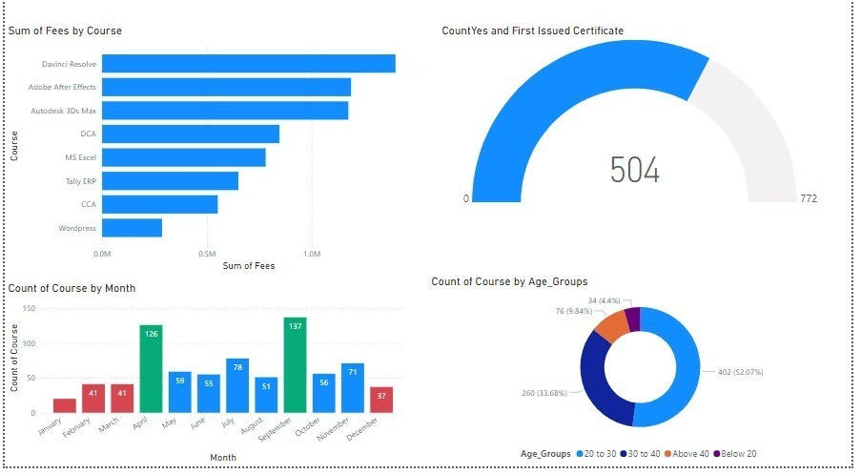
PROJECT OVERVIEW
Visual
Sum of Fees by Course (Bar Chart)
Certificate Issued Gauge (504)
Course Count by Month (Column Chart)
Age Group Distribution (Donut Chart)

Slide 7
Key Insights Summary
Advanced software courses generate highest revenue Young adults dominate enrollment October & April show peak demand Certificate completion rate needs improvement

Slide 8
Business Recommendations
Focus marketing on 20–30 age group
Improve certification completion strategy
Promote high-revenue software courses
Introduce beginner-level short-term programs
Offer festive discounts during low months

Slide 9
Conclusion
Track revenue performance
Monitor student enrollment trends
Analyze demographic distribution
Improve certification success rate
Make data-driven business decisions

